Slide 1
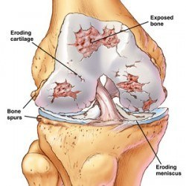
Degenerative Joint Disease include:
Primary DJD is a degeneration of cartilage in elderly individuals occurring for no known reason
Secondary DJD develops secondarily from known conditions that affect the joint and supporting structures. This is perhaps the most common type observed in small animals.

Slide 2
Degeneration of the Articular Cartilage
compression or shear stresses
releasing cathepsin, which in turn induces loss of proteoglycans and water.
cell damage
so that fissuring (fibrillation) occurs
1. decreases cartilage resiliency
2. leaves collagen exposed.
then occurs
Additional chondrocyte damage
And the cycle continues
additional cathepsin is released

Slide 3
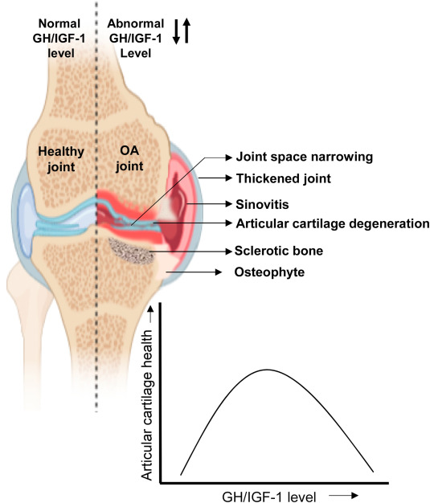
With
degradative enzymes,
lack of orientation in regenerating tissue, and
abnormal stress caused by these unstable joints,
physiological repair attempts are usually negligible.

Slide 4
Two changes in bone occur in the presence of osteoarthrosis:
the production of marginal osteophytes
the appearance of subchondral sclerosis
Osteophytes sometimes form in an area not covered by synovium. Bone spurs that form outside joints where tendons insert are termed enthesiophytes.
Changes in Synovial Membrane
The synovial membrane in DJD generally appears normal. The surface may show some hyperplasia, but minimal inflammatory response.

Slide 5
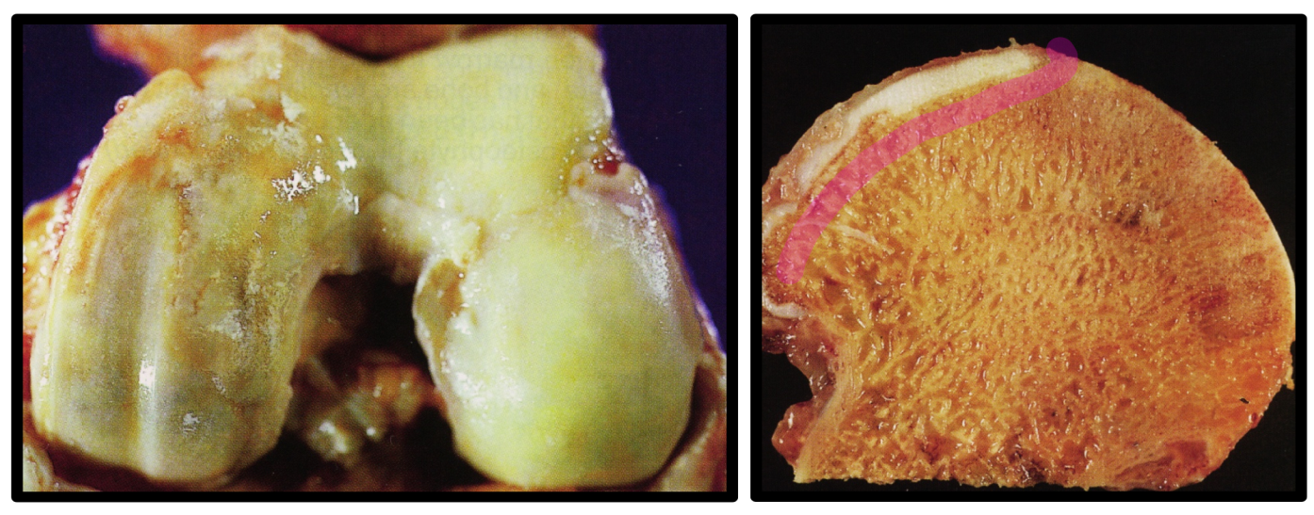
Early gross changes in articular cartilage consist of a localized, soft or velvety area that changes to a yellow to dull-white color with pits, and with depressions and linear grooves becoming apparent. . In advanced disease the cartilage may be soft and spongy. In areas where subchondral bone is exposed and subjected to wear, a highly polished eburnated surface may be present. In joints with apposing articular surfaces, “kissing” or mirror-image lesions develop
Changes in Cartilage

Slide 6
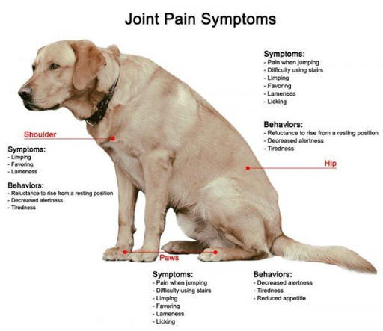
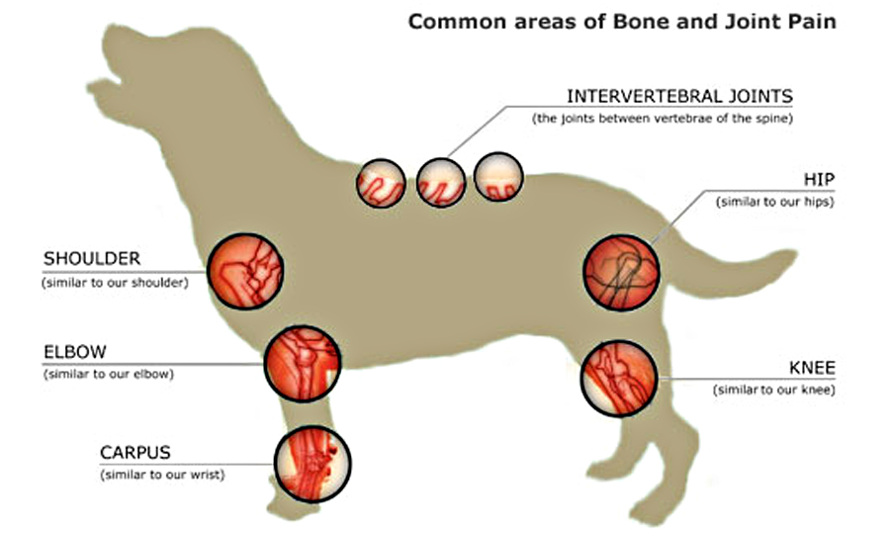
Clinical Signs
Pain.
Stiffness.
Crepitation.
Obesity.
Age

Slide 7
Treatment
Objectives
Objectives of treatment for osteoarthrosis in animals are
(1) to relieve pain,
(2) to maintain function and range of motion (unless undertaking arthrodesis), and
(3) to maintain or regain normal activity.
1. Rest: includes short walks on leash and elimination of running and jumping. When the animal is overusing a joint affected by early osteoarthrosis, or in cases of early traumatic arthroses, coaptation splints, casts, or slings for 2 to 3 weeks may be useful

Slide 8
2. Heat: to relieve muscle spasm and pain.
soaking a facecloth or towel in fairly warm water and applying it around the joint for 10 minutes, two or three times per day.
Therapeutic ultrasound: applying heat in animals, 5 to 10 watts (total dose) twice daily for 5 to 10 days.
In acute joint injuries, cold rather than heat is indicated to decrease pain, swelling, and hematoma formation.
3. Exercise:
Swimming is an excellent exercise for osteoarthrosis of joints because non–weight-bearing ROM (range of motion) exercise decreases joint capsule adhesions.
4. Medications

Slide 9
4. Medications
Most medications do nothing to reverse osteoarthritis, for the most part to decrease pain and discomfort. any pain-reducing drugs should be accompanied by rest.
Nonsteroidal anti inflammatory drugs (NSAIDs) are anti inflammatory, analgesic, and antipyretic. The inflammatory cascade has been simplified, as follows:
The NSAIDs block the cascade from cyclooxygenase (COX) to prostaglandin, thereby decreasing inflammation.
Tissue damage
Prostaglandin synthase (cyclooxygenase)
Prostaglandin

Slide 10
COX-1: performs homeostatic mechanisms, including manufacture of prostaglandins that protect the GI tract. COX-1 inhibitors can lead to GI erosions and ulceration.
COX-2 is not normally found in most tissues and helps transmit pain and accelerates inflammation.
the COX-2 inhibitors are theoretically a better choice of drug with fewer undesirable side effects.

Slide 11
Aspirin: in humans is reported to inactivate COX permanently (until new cells are formed), where as other NSAIDs are competitive inhibitors and reversible.
Aspirin in cats can be quite toxic (platelet dysfunction), but administration every third day in low doses is a widely used prophylaxis treatment for thromboembolism. 5. Diet:
Weight reduction alone has been very effective for some animals in reducing pain from osteoarthrosis.

Slide 12
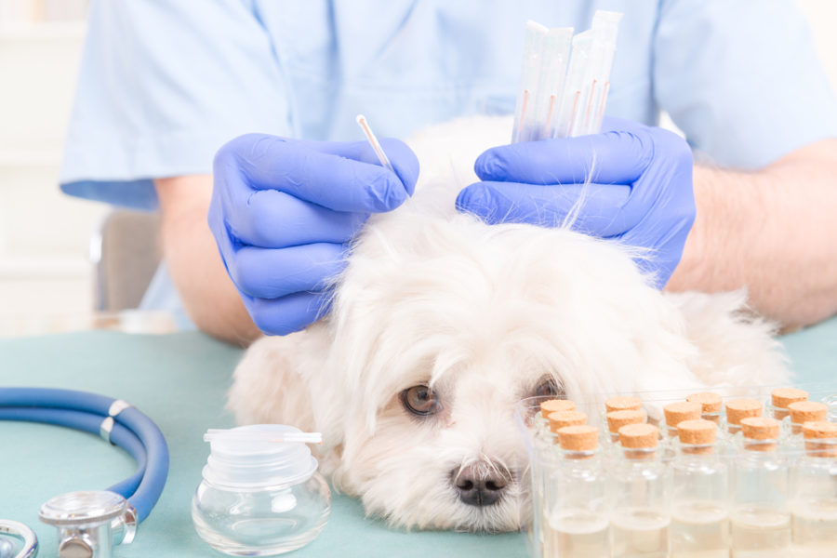
5. Acupuncture:
A prospective study failed to show any clinical improvement based on owner questionnaire or veterinary physical examination. Objective measurements using force plate and kinematic gait analysis showed no statistical differences.

Slide 13
Surgical Methods
Is used when pain or function is not helped by reasonable conservative measures.
Procedures include.
limb amputation
neurectomy
pseudoarthrosis
osteotomy
arthroplasty
arthrodesis (bony, fusion of a joint),
soft tissue or muscle release
debridement of osteophytes and joint surfaces

